Slide 1
DRIVe Overview for
M2D2 JLABS DC Accelerator Event
Sandeep Patel
Division of Research Innovation and Ventures (DRIVe)
07 October 2020

Slide 2

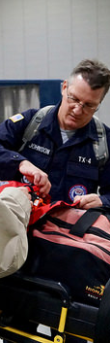
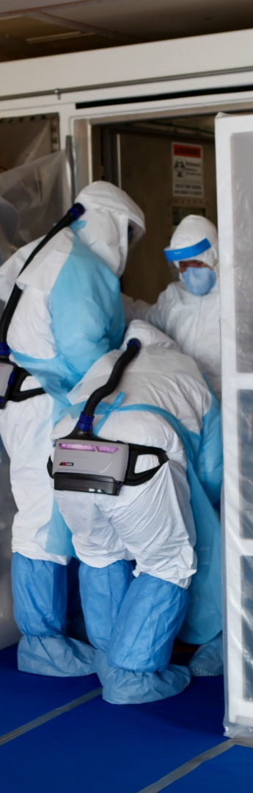
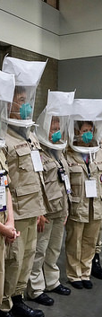

ASPR Mission
Save Lives and Protect Americans from 21st Century Health Security Threats

Slide 3

The BARDA Model
BARDA develops and makes available medical countermeasures (MCMs) by forming unique public-private partnerships to drive innovation off the bench to the patient to save lives.
Flexible, nimble authorities
Multi-year funding
Cutting edge expertise
Facilitate partnerships
Promote innovation

Slide 4




BARDA Program Divisions
Medical Countermeasures (MCM) Program
Influenza & Emerging Infectious Diseases
Chemical, biological, radiological and nuclear (CBRN) Program
Detection, Diagnostics, & Device Infrastructure
Pharmaceutical Countermeasure Infrastructure
Division of Research, Innovation, and Ventures (DRIVe)

Slide 5



DRIVe Program Areas
ENACT
SEPSIS
DRIVe Interface Office
Supporting pathogen-agnostic technologies that enable earlier infection diagnoses
Reducing the incidence, morbidity, mortality, and cost of sepsis
Bridging the intersection between the science and the business world

Slide 6
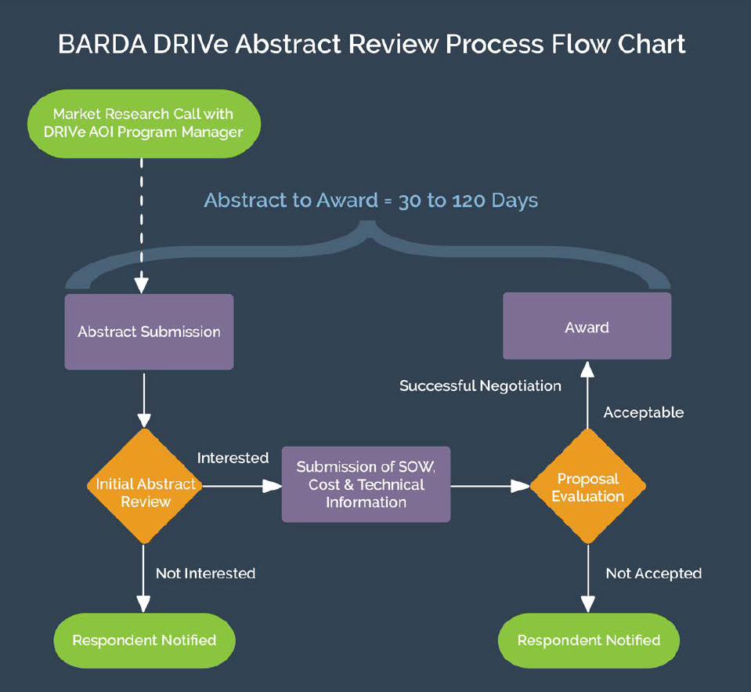
DRIVe R&D Funding Vehicle
Easy Broad Agency Announcement (EZ-BAA) is designed to be fast, easy-to-use, and flexible
Inspired by DARPA
$749,999 max & 30-50% cost share requirement
Can go from posting solicitation to award within 30 days

Slide 7


























DRIVe Portfolio Companies
26 funded companies
$29.5 million funded
$19.5 million cost share

Slide 8


Questions?
www.DRIVe.hhs.gov
Donna Boston
Project Officer
Donna.Boston@hhs.gov
Sandeep Patel, PhD
DRIVe Director
Sandeep.Patel@hhs.gov

Slide 9











How to Contact BARDA
medicalcountermeasures.gov Portal to BARDA: Register to request a TechWatch meeting!
beta.sam.gov/ Official announcements and info for all government contract solicitations
phe.gov/BARDA Program description, information, news, announcements
drive.hhs.gov Learn about DRIVe, including our Accelerator Network and EZ BAA
www.usajobs.gov Join the team!

